Slide 1

Design Of Differential-mode (DM) Active EMI Filter for ISOP LLC converters
Suhani Biswal

Slide 2
Objectives of This Work
Design and simulation of a DM Active EMI filter
Studying DM noise spectrums at the LISN under various conditions with and without AEF
Ensuring EMC compliance is achieved in the Sentry schematic according to CISPR 32 standards

Slide 3
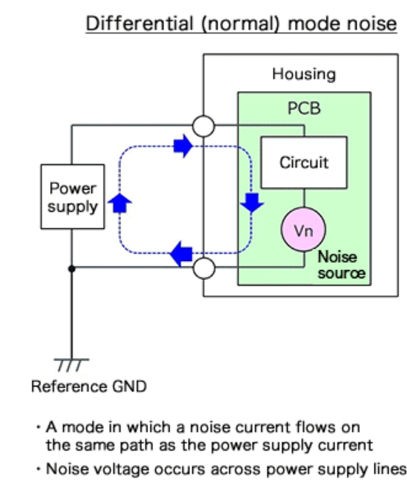
Differential-mode (DM) noise | Introduction
In differential mode noise, the noise source appears across power supply lines and is in series with the power supply line, and the noise current flows in the same direction as the power supply current. It is called “differential mode” because the outgoing and return currents are oppositely-directed.
The source of differential mode noise is the switching node, which causes high di/dt due to coupling with nearby capacitors, that travels across the circuit and reaches the power lines.
For DM noise a single unit of LISN is required, connected between the line and neutral rails. For this project I’ve used the 50uH/8uF LISN setup, which is used in industrial or residential applications. It mimics the SIMPLIS LISN module available for the same specifications.

Slide 4
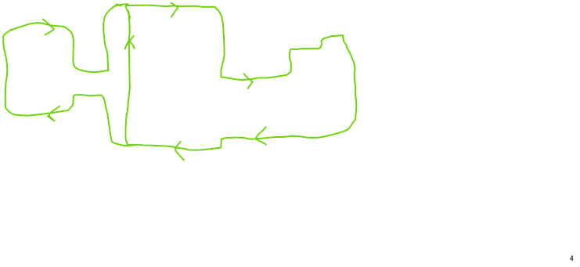
DM noise path in LLC converter circuit (With LISN)
LISN
Switching node
(source of DM noise)

Slide 5
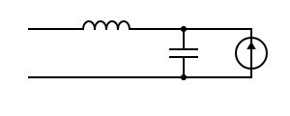

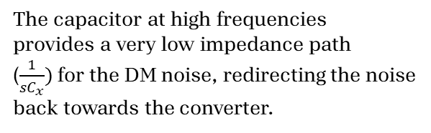
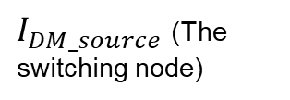
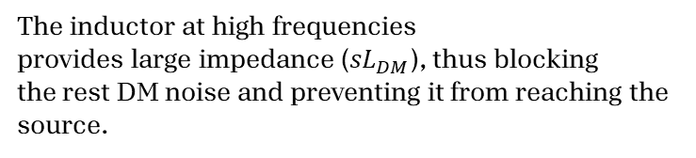

Passive filters for suppressing DM noise
The inductor at high frequencies
provides large impedance (${sL}_{DM}$), thus blocking
the rest DM noise and preventing it from reaching the
source.
$$L_{DM}$$
LISN
$$C_{x}$$
$I_{DM_source}$ (The switching node)
The capacitor at high frequencies
provides a very low impedance path
($\frac{1}{sC_{x}})$ for the DM noise, redirecting the noise
back towards the converter.

Slide 6
Active EMI Filters | Introduction
The Need
DM inductors dominate the size of the EMI filter, and bring several challenges during EMI filter design – including bulky volume, thermal management issues, acoustic noise, filter resonances and electromagnetic coupling between components.
In addition, the X-capacitors used for passive filtering in high voltage applications are also very bulky and consume a lot of space
The AEF circuit connects to the lines between the EMI source and the EMI victim.
Unlike a passive filter, an AEF circuit uses active devices and control to sense the residual (DM or CM) voltage or current disturbance, and injects an opposing signal that directly negates that noise disturbance, essentially a destructive interference.
The expectation is that AEF significantly reduces EMI, resulting in a smaller-size filter versus a traditional passive-only design with equivalent attenuation.

Slide 7
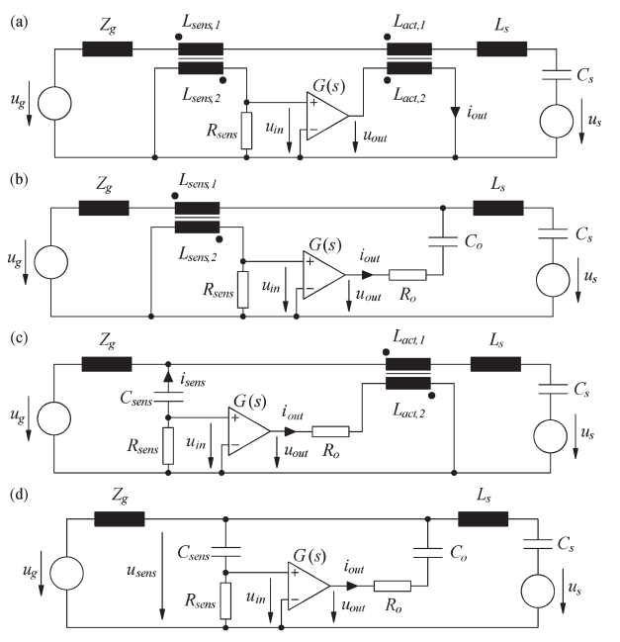
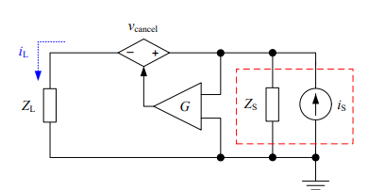
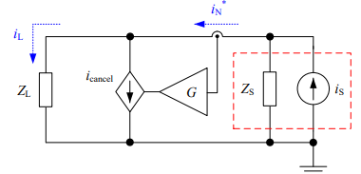
Active EMI Filters | Configurations
The design and implementation of AEF and HEF circuits depend on the path of conduction (DM or CM) and the required sensing, gain and injection stages.
There are two kinds of control structures: Feedback (FB) and Feedforward (FF)
Feedback topologies a) CSVI, b) CSCI, c) VSVI, d) VSCI
Feedforward topologies VSVI and CSCI

Slide 8
Selection of Active Filter Topology: Why Avoid Current Transformers?
Wide bandwidth requirement
EMI suppression must be effective from 150 kHz to 30 MHz, requiring a current transformer with excellent high-frequency response.
Magnetic material limitations
Conventional core materials exhibit reduced permeability at high frequencies, degrading sensing accuracy.
Thus, our choice :
A Voltage-Sensing Current-Injection (VSCI) topology using capacitive sensing and capacitive injection was selected. BENEFITS: • Eliminates bulky HF current transformers. • Smaller size and lower cost. • Better suitability for high-frequency EMI suppression. • Easier integration with existing X-capacitor-based differential-mode filters.
Self-resonance issues
Transformer parasitics can create unwanted resonances that affect filter stability and attenuation.
Increased size and cost:
High-performance HF current transformers add significant volume and expense to the EMI filter.

Slide 9
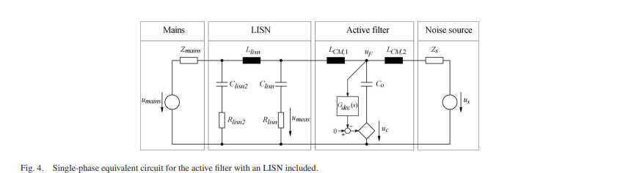
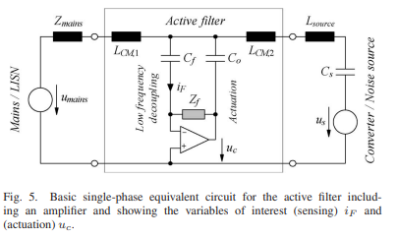

Slide 10
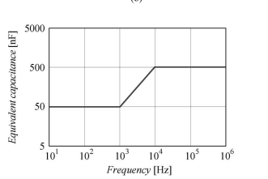

Capacitive Amplification
The basic principle of the topology is to increase the equivalent capacitance for high frequencies by using a feedback loop. For the lower frequency end, the original capacitance of Co is effective, but for higher frequencies, an increase in the capacitance is possible as the feedback-gain increases, as per the following equation:
The capacitive impedance decreases according to the above equation, making the X capacitor appear larger than it physically is. This solves the problem of constraint on the size of the X capacitor , and thus the DM inductor size can be decreased.

Slide 11
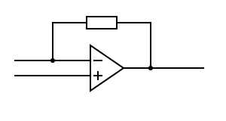
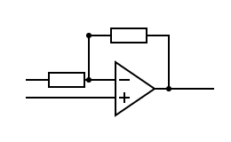



















Capacitive Amplification
The basic principle of the topology is to increase the equivalent capacitance of the x-capacitor for high frequencies by using a feedback loop. This is done using the Miller effect.
$$I_{in}$$
$$Z_{f}$$
$$Z_{f}$$
$$Z_{2}$$
$$Z_{1}$$
$$V_{in}$$
$$G$$
$${−G(s)V}_{in}$$
G(s)$=−\frac{Z_{2}}{Z_{1}}$
$$Z_{m}$$
$I_{in}= \frac{V_{in}(1+G(s))}{Z_{f}}$ $=> \frac{V_{in}}{I_{in}}=Z_{m}=\frac{Z_{f}}{(1+G(s))} =>$ $C_{m}= C_{f}(1+G(s))$
$$Z_{o}$$
$$Z_{i}$$
$$Z_{o}$$
$$Z_{i}$$
Thus the overall setup
of an AEF is something like this:
$$Z_{f}$$
Equivalent
$$Z_{f}$$
$$Z_{1}$$
$$Z_{2}$$
Converter
$$Z_{2}$$
Converter
$$Z_{1}$$

Slide 12
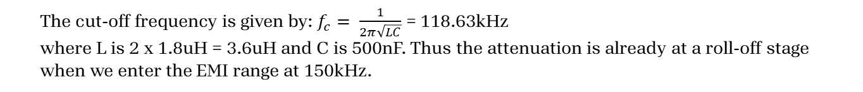
Choice of Passives
Passive filter
1.8u
1.8u
LISN
EUT
AEF
The cut-off frequency is given by: $f_{c}= \frac{1}{2π\sqrt{LC}}$ = 118.63kHz
where L is 2 x 1.8uH = 3.6uH and C is 500nF. Thus the attenuation is already at a roll-off stage when we enter the EMI range at 150kHz.

Slide 13
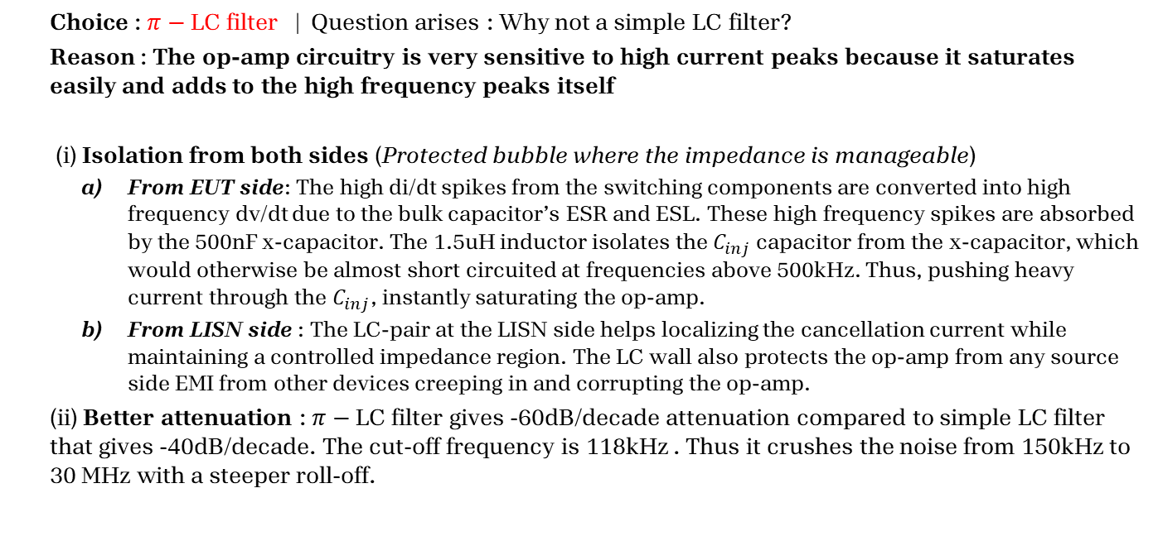
Choice of Passives| Topology
Choice : $π−$LC filter | Question arises : Why not a simple LC filter?
Reason : The op-amp circuitry is very sensitive to high current peaks because it saturates easily and adds to the high frequency peaks itself
(i) Isolation from both sides (Protected bubble where the impedance is manageable)
From EUT side: The high di/dt spikes from the switching components are converted into high frequency dv/dt due to the bulk capacitor’s ESR and ESL. These high frequency spikes are absorbed by the 500nF x-capacitor. The 1.5uH inductor isolates the $C_{inj}$ capacitor from the x-capacitor, which would otherwise be almost short circuited at frequencies above 500kHz. Thus, pushing heavy current through the $C_{inj}$, instantly saturating the op-amp.
From LISN side : The LC-pair at the LISN side helps localizing the cancellation current while maintaining a controlled impedance region. The LC wall also protects the op-amp from any source side EMI from other devices creeping in and corrupting the op-amp.
(ii) Better attenuation : $π−$LC filter gives -60dB/decade attenuation compared to simple LC filter that gives -40dB/decade. The cut-off frequency is 118kHz . Thus it crushes the noise from 150kHz to 30 MHz with a steeper roll-off.

Slide 14
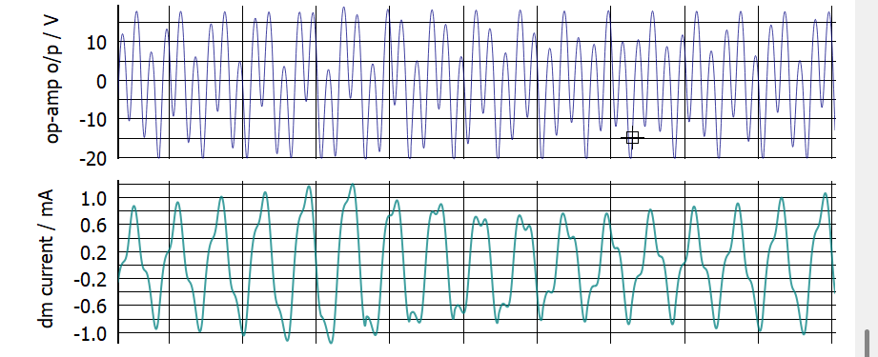
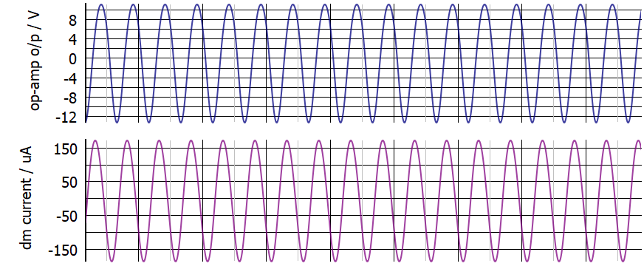
Choice of Passives | Addition of snubber
A snubber circuit is
added to dampen
LC resonance occurring in
the passives. Without
the snubber, a large
low frequency component
is introduced to the op-amp output. It distorts the waveform and increases the dm current.
RC Snubber
LISN
EUT
250n
1
Without snubber
With snubber

Slide 15
Components of proposed DM EMI filter
Sensing stage
Gain stage
Injection stage
Gain and Phase Plot of the standalone AEF:
Sensed
from
line
Injected
into
line
Referenced to neutral

Slide 16


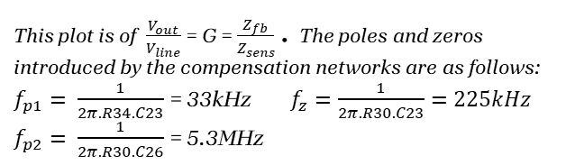
Gain and Phase curves of the compensation network (isolated)
Zero at 225kHz
1. The Differentiator Climb: The R34 in the compensation network dominates and the gain = sC24*R34. Thus opamp acts as a differentiator. Hence gain slope is +20dB/dec and phase starts from +90 degrees.
LF pole
At 33kHz
$$Z_{sens}$$
2. The Baseline gain region : The first pole is at 33kHz. It adds a -20dB/dec. flattening the zone. The gain here is given by C24/C23 = 24.6dB. It sets a baseline gain before the zero hits, thus selection of these parameters is incredibly important. The phase plummets to around 40 degrees .
$$Z_{fb}$$
800p
3. The Stabilizing zero: The zero is at 225kHz. It adds a +20dB/dec rise in slope allowing the opamp to fight harder in the critical 500kHz to 1MHz zone.The phase stops dropping here and is held steady.
10
4. The silicon limit is reached: The gain hits a peak of roughly 40dB around 1MHz and then abruptly rolls over and starts falling. Mathematically the HF pole at 6MHz should have held the gain stable at around 55dB. But it is greater than maximum possible gain at 5.3MHz that is around 25dB. This is due to the Gain Bandwidth Product (GBW) of the opamp. The gain slope gradually rolls off at -20dB/ dec.
This plot is of $\frac{V_{out}}{V_{line}}$ = G = $\frac{Z_{fb}}{Z_{sens}}$ . The poles and zeros introduced by the compensation networks are as follows:
$f_{p1}= \frac{1}{2π.R34.C23}$ = 33kHz $f_{z}=\frac{1}{2π.R30.C23}=225kHz$
$f_{p2}= \frac{1}{2π.R30.C26}$ = 5.3MHz

Slide 17
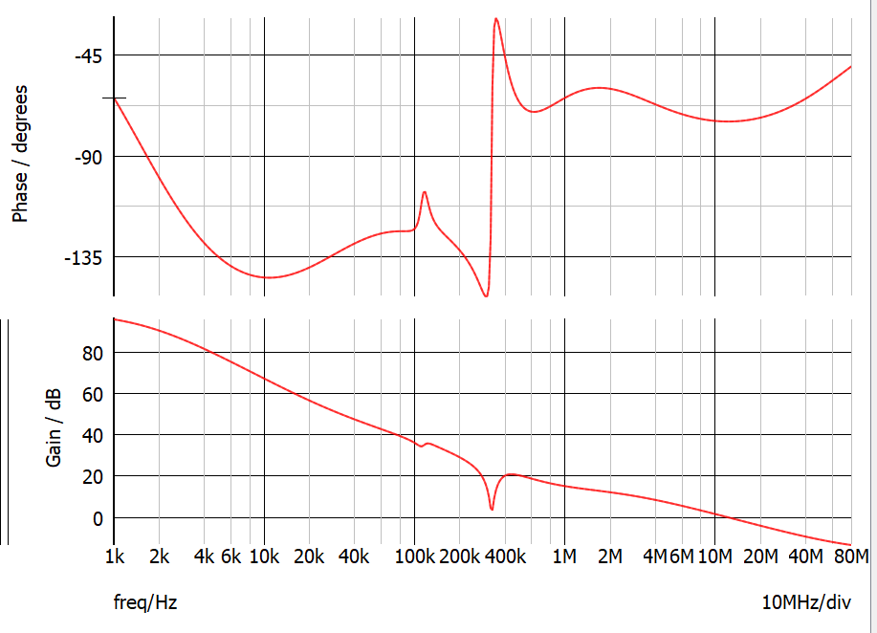
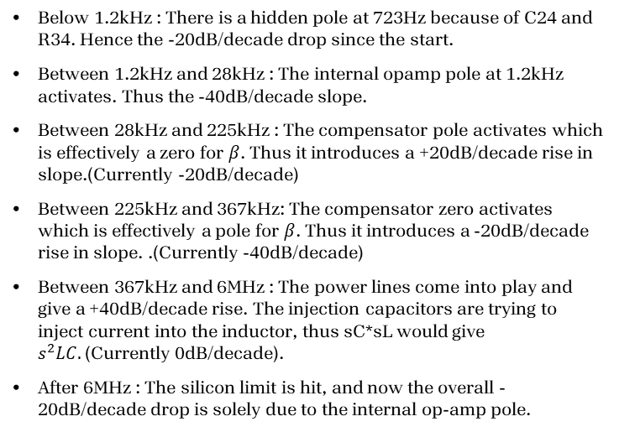
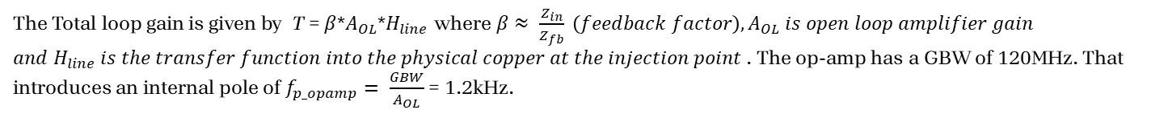
Total Loop Gain and Phase curves of the compensation network (with power line effects)
The Total loop gain is given by T = $β$*$A_{OL}$*$H_{line}$ where $β≈ \frac{Z_{in}}{Z_{fb}} \left(feedback factor\right),A_{OL} is open loop amplifier gain$
$and{ H}_{line} is the transfer function into the physical copper at the injection point$. The op-amp has a GBW of 120MHz. That introduces an internal pole of $f_{p_opamp}= \frac{GBW}{A_{OL}}$ = 1.2kHz.
Below 1.2kHz : There is a hidden pole at 723Hz because of C24 and R34. Hence the -20dB/decade drop since the start.
Between 1.2kHz and 28kHz : The internal opamp pole at 1.2kHz activates. Thus the -40dB/decade slope.
Between 28kHz and 225kHz : The compensator pole activates which is effectively a zero for $β$. Thus it introduces a +20dB/decade rise in slope.(Currently -20dB/decade)
Between 225kHz and 367kHz: The compensator zero activates which is effectively a pole for $β$. Thus it introduces a -20dB/decade rise in slope. .(Currently -40dB/decade)
Between 367kHz and 6MHz : The power lines come into play and give a +40dB/decade rise. The injection capacitors are trying to inject current into the inductor, thus sC*sL would give $s^{2}LC.$(Currently 0dB/decade).
After 6MHz : The silicon limit is hit, and now the overall -20dB/decade drop is solely due to the internal op-amp pole.
Actual
Expected

Slide 18
Total Loop Gain and Phase curves of the compensation network (with power line effects)
The Total loop gain is given by T = $β$*$A_{OL}$*$H_{line}$ where $β≈ \frac{Z_{in}}{Z_{fb}} \left(feedback factor\right),A_{OL} is open loop amplifier gain$
$and{ H}_{line} is the transfer function into the physical copper at the injection point$. The op-amp has a GBW of 120MHz. That introduces an internal pole of $f_{p_opamp}= \frac{GBW}{A_{OL}}$ = 1.2kHz.
The phase stays bounded between 0˚ to -180˚. It never warps around to -360˚.
Gain crossover frequency : 13MHz
Phase Margin : At Gain crossover frequency, the phase is at -75 ̊
Thus PM = 180 + (-75) = 105 ̊
( Minimum PM required is 45̊. )
Thus we have a stable system.
Actual
Expected

Slide 19
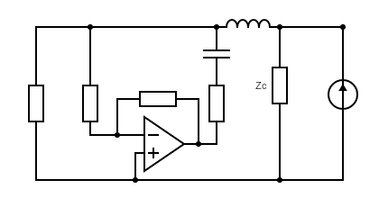
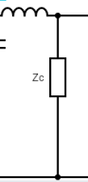
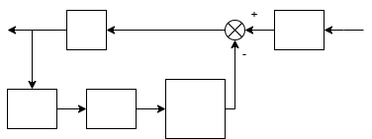




























Control loop block diagram of the AEF
Equivalent model of the AEF circuit
Simplified block diagram
$$I_{dm_source}$$
$$L_{1}$$
$$V_{line}$$
$$I_{line}$$
$$L_{2}$$
HPF
$$C_{inj}$$
$$I_{inj}$$
$$V_{line}$$
$$I_{line}$$
$$I_{dm_source}$$
$$I_{noise_source}$$
$$Z_{L}$$
$$\frac{Z_{c}}{Z_{c}+Z_{A}}$$
$$C_{x1}$$
$$Z_{sens}$$
$$Z_{fb}$$
$$I_{noise}$$
$$C_{x2}$$
$$Z_{eq}$$
$$R_{inj}$$
$$V_{out}$$
$$I_{inj}$$
$$V_{in}$$
$$V_{out}$$
HPF
G =$\frac{Z_{fb}}{Z_{sens}}$
$$\frac{(1−G)}{G(R_{inj}+\frac{1}{sC_{inj}})}$$
AEF block

Slide 20
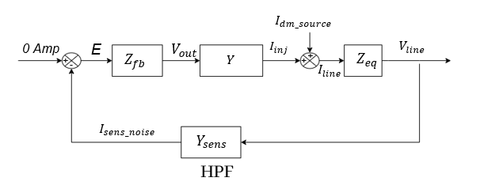
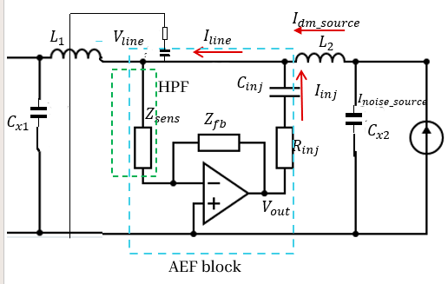
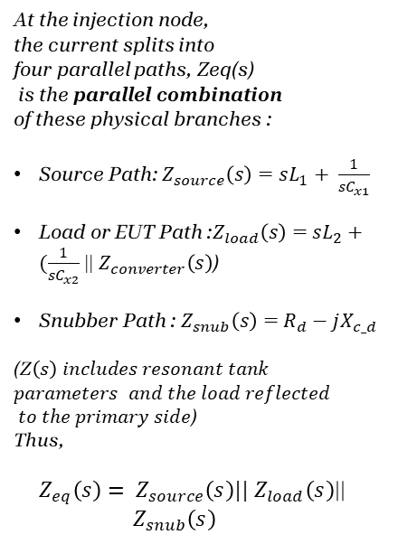
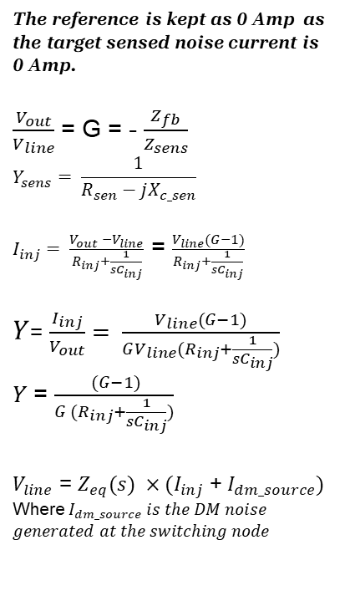

Control loop block diagram of the AEF
The reference is kept as 0 Amp as
the target sensed noise current is
0 Amp.
$\frac{V_{out}}{V_{line}}$ = G = - $\frac{Z_{fb}}{Z_{sens}}$
$$Y_{sens}= \frac{1}{R_{sen}−jX_{c_sen}}$$
$I_{inj}= \frac{V_{out} −V_{line}}{R_{inj}+\frac{1}{sC_{inj}}}$ = $\frac{V_{line}(G−1)}{R_{inj}+\frac{1}{sC_{inj}}}$
$Y$= $\frac{I_{inj}}{V_{out}}= \frac{V_{line}(G−1)}{GV_{line}(R_{inj}+\frac{1}{sC_{inj}})}$
$Y$= $\frac{ (G−1)}{G (R_{inj}+\frac{1}{sC_{inj}})}$
$V_{line}$ = $Z_{eq}(s) ×(I_{inj}$ + $I_{dm_source})$
Where $I_{dm_source} is the DM noise$
$$generated at the switching node$$
At the injection node,
the current splits into
four parallel paths, Zeq(s)
is the parallel combination
of these physical branches :
Source Path: $Z_{source}\left(s\right)=sL_{1}+ \frac{1}{sC_{x1}}$
Load or EUT Path :$Z_{load}\left(s\right)=$ $sL_{2}+(\frac{1}{sC_{x2}}$ || $Z_{converter}\left(s\right)$)
Snubber Path : $Z_{snub}\left(s\right)=$ $R_{d}−jX_{c_d}$
(Z$\left(s\right) includes resonant tank$
$$parameters and the load reflected$$
$to the primary side$)
Thus,
${ Z}_{eq}\left(s\right)= Z_{source}\left(s\right)||$ $Z_{load}\left(s\right)$|| ${ Z}_{snub}\left(s\right)$
$$Z_{converter}\left(s\right)$$

Slide 21
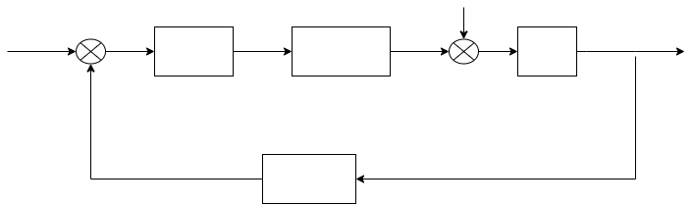







$$I_{dm_source}$$
0 Amp
E
$$V_{out}$$
$$I_{inj}$$
+
$$V_{line}$$
+
$$Z_{fb}$$
+
$$Z_{eq}$$
$$Y$$
-
$$I_{line}$$
$$I_{sens_noise}$$
$$Y_{sens}$$
HPF

Slide 22
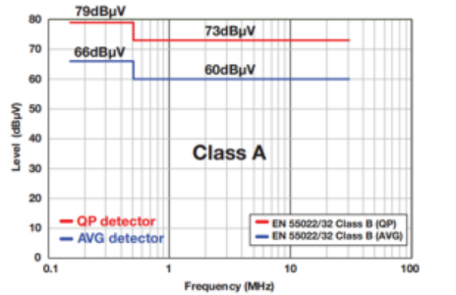
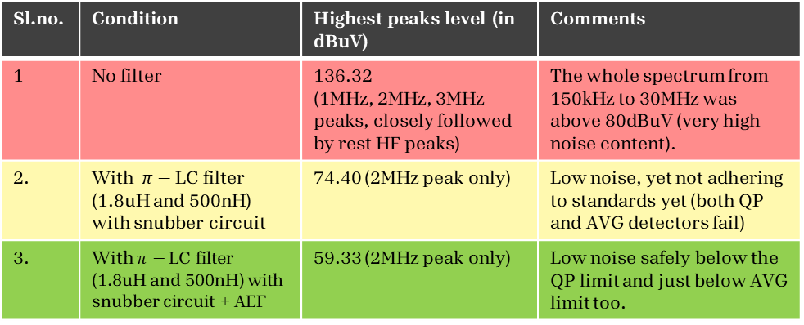
Results| Summary
Target EMI limit : CISPR 32 Class A
Sl.no. | Condition | Highest peaks level (in dBuV) | Comments
1 | No filter | 136.32 (1MHz, 2MHz, 3MHz peaks, closely followed by rest HF peaks) | The whole spectrum from 150kHz to 30MHz was above 80dBuV (very high noise content).
2. | With $π−$LC filter (1.8uH and 500nH) with snubber circuit | 74.40 (2MHz peak only) | Low noise, yet not adhering to standards yet (both QP and AVG detectors fail)
3. | With $π−$LC filter (1.8uH and 500nH) with snubber circuit + AEF | 59.33 (2MHz peak only) | Low noise safely below the QP limit and just below AVG limit too.
The EMI voltage being
measured is a continuous
signal in time domain. Hence its peak
= quasi-peak
Thus it passes both QP and AVG detectors
with the AEF.
Studying the decrease in size of passives
With the use of AEF
Configuration | Inductor size | X-capacitor size | Comments | Attenuation (in dBuV
Only Passives (Without AEF) | 2.5uH | 1uF | Bulkier passives | 58.87
With Passives + AEF | 1.8uH (30% ) | 500nF (50% ) | Lighter passives | 59.33
If we use passive filters only, we’ll have to use larger inductors and x-capacitors for the same attenuation. Use of AEF leads to 50% decrease in size of x-capacitors and 30% decrease in inductor size
in the circuit.

Slide 23
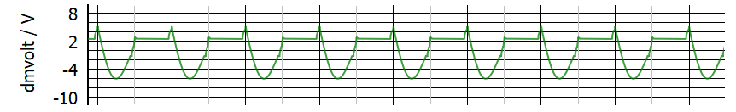
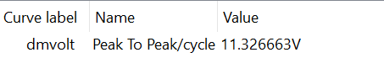
ISOP topology – DM noise profile
QP
AVG
79dBuV
73dBuV
66dBuV
60dBuV

Slide 24
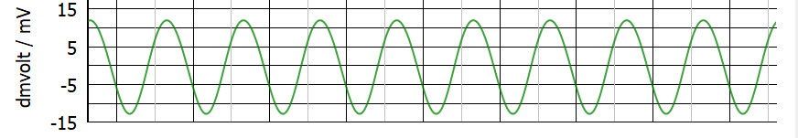
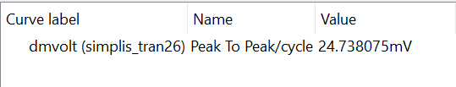
ISOP topology- DM noise profile with passives only
QP
AVG
79dBuV
73dBuV
66dBuV
60dBuV

Slide 25
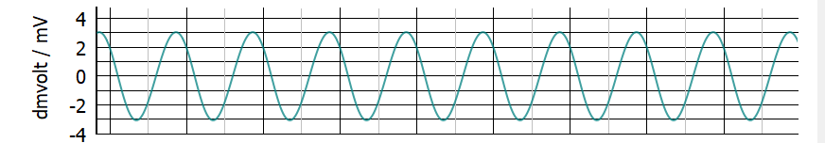
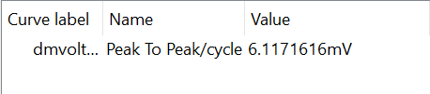
ISOP topology- DM noise profile with passives+AEF
QP
AVG
79dBuV
73dBuV
66dBuV
60dBuV

Slide 26
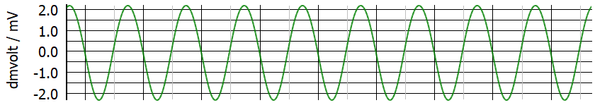

ISOP topology- DM noise profile with increased passives
QP
AVG
The passives were increased
to 2.5uH and 1uF to get the
same attenuation as the case
lighter passives and AEF.
79dBuV
73dBuV
66dBuV
60dBuV

Slide 27
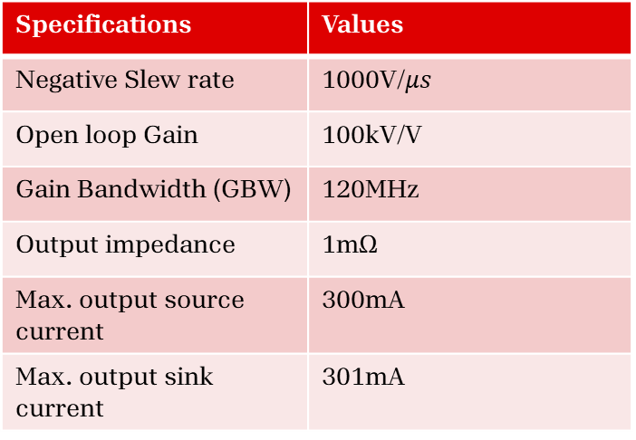
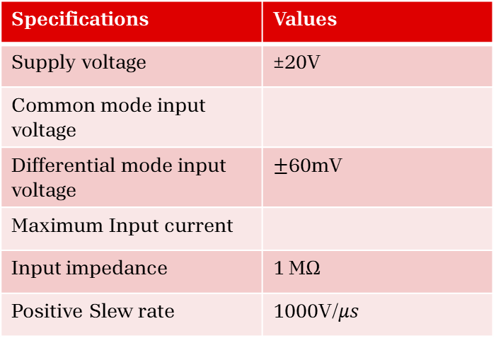
Specifications of Op-Amp used
Specifications | Values
Supply voltage | ±20V
Common mode input voltage
Differential mode input voltage | $±$60mV
Maximum Input current
Input impedance | 1 MΩ
Positive Slew rate | 1000V/$μs$
Specifications | Values
Negative Slew rate | 1000V/$μs$
Open loop Gain | 100kV/V
Gain Bandwidth (GBW) | 120MHz
Output impedance | 1mΩ
Max. output source current | 300mA
Max. output sink current | 301mA

Slide 28

ISOP topology- DM noise profile with AEF

Slide 29
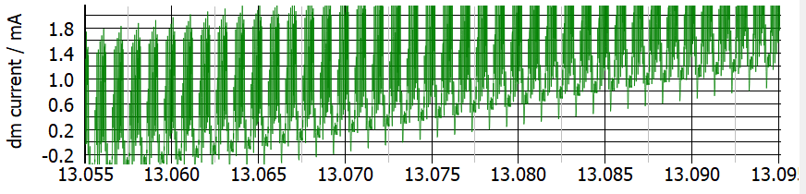
Sentry Schematic - DM noise profile
1MHz peak – 70dBuV
2MHz peak – 55dBuV

Slide 30
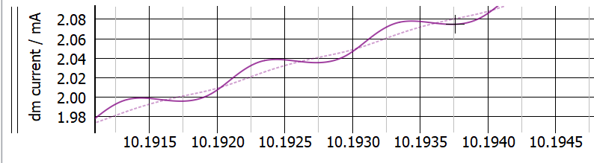
Sentry Schematic – With passives only

Slide 31
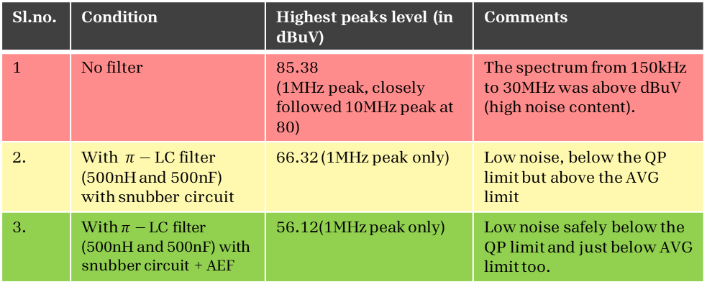
Results for Sentry Schematic| Summary
Target EMI limit : CISPR 32 Class A
Sl.no. | Condition | Highest peaks level (in dBuV) | Comments
1 | No filter | 85.38 (1MHz peak, closely followed 10MHz peak at 80) | The spectrum from 150kHz to 30MHz was above dBuV (high noise content).
2. | With $π−$LC filter (500nH and 500nF) with snubber circuit | 66.32 (1MHz peak only) | Low noise, below the QP limit but above the AVG limit
3. | With $π−$LC filter (500nH and 500nF) with snubber circuit + AEF | 56.12(1MHz peak only) | Low noise safely below the QP limit and just below AVG limit too.
The EMI voltage being
measured is a continuous
signal. Hence its peak
= quasi-peak
Thus it passes both QP and AVG detectors.
Studying the decrease in size of passives
with the use of AEF
Configuration | Inductor size | X-capacitor size | Comments | Attenuation (in dBuV
Only Passives (Without AEF) | 800nH | 800nF | Bulkier passives | 55.33
With Passives + AEF | 500nH (30% ) | 500nF (30% ) | Lighter passives | 56.12
If we use passive filters only, we’ll have to use larger inductors and x-capacitors for the same attenuation. Use of AEF leads to 30% decrease in size of both x-capacitors and inductor size
in the circuit.

Slide 32
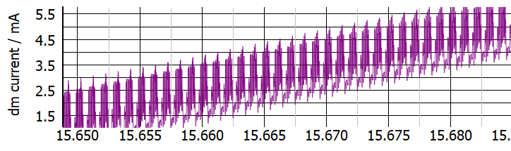
Sentry Schematic – Without any filter
QP
AVG
79dBuV
73dBuV
66dBuV
60dBuV

Slide 33
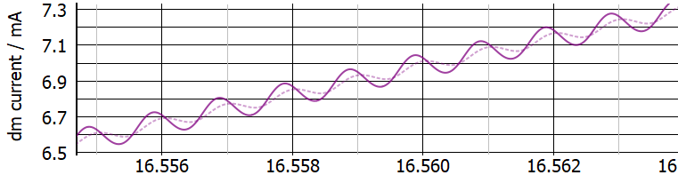
Sentry Schematic – With passives only
QP
AVG
79dBuV
73dBuV
66dBuV
60dBuV

Slide 34
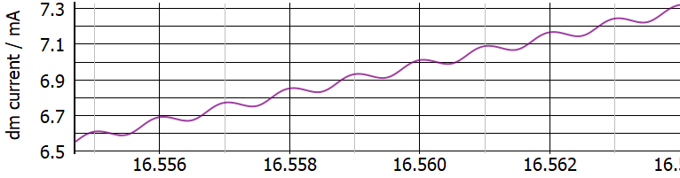
Sentry Schematic – With passives + AEF
QP
AVG
79dBuV
73dBuV
66dBuV
60dBuV

Slide 35
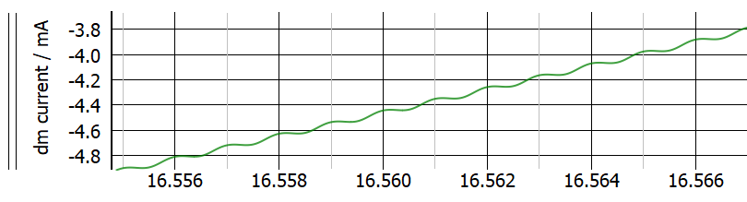
Sentry Schematic – With increased passives
QP
AVG
The passives were increased
to 800nH and 800nF to get the
same attenuation as the case
lighter passives and AEF.
79dBuV
73dBuV
66dBuV
60dBuV

Slide 36
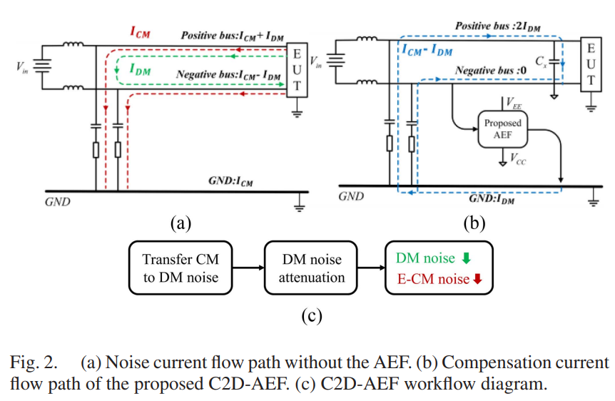
C2D (CM to DM conversion)
The CM noise can be converted into DM noise by actively forcing the noise in the ground into the Neutral line, by using an active circuit
Reference: H. Wang et al., "A Novel Active EMI Filter Based on Transferring Common-Mode Noise to Differential-Mode Noise," IEEE Transactions on Power Electronics, vol. 40, no. 7, p. 8950, July 2025.

Slide 37
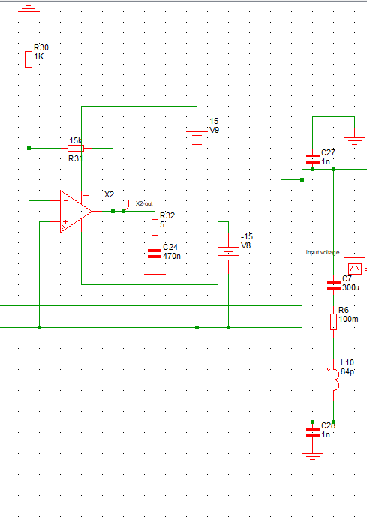
The Active circuit involved
Line
LISN
DM filter
EUT
LISN
Neutral
C2D conversion
ckt
Ground

Slide 38
Schematic

Slide 39
Targeting CM using C2D | Case 1 : Without filter

Slide 40
Targeting CM + DM | Case 2: With just Y-cap
-9dBuV

Slide 41
Targeting CM using C2D | Case 3: With C2D AEF + Y-cap
-17dBuV

Slide 42
ISOP topology- CM noise profile without filter

Slide 43
ISOP topology – CM noise profile with Y-caps only

Slide 44
ISOP topology – CM noise profile with Y-caps + CM choke

Slide 45
ISOP topology- CM noise profile with added C2D AEF

Slide 46
Thank you…!

